Slide 1
Netflix Stock Profile
Understanding Netflix stock data using Python and data visualization techniques.

Slide 2
Utilizing DATA Visualizations to determine the Netflix Stock Profile
Conclusions:
After parsing through and organizing the data into graph visualizations using Python, Matplotlib and Seaborn, it has been determined that the Netflix stock profile is growing, is often close to Yahoo finance projections, and while more volatile than the Dow Jones average, growing positively overall. Additionally, Netflix revenue and earnings have slowly, but steadily grown over 2017.
Four different graphs were used to understand the Netflix Stock Profile:
Violin plot comparing the distribution of Netflix stock prices by quarter.
Overlapping scatter plot that compares estimated and actual EPS each quarter.
Side by side bar graph differentiating revenue versus earnings each quarter.
Side by side line graphs comparing the Netflix stock price to the Dow Jones stock price.

Slide 3
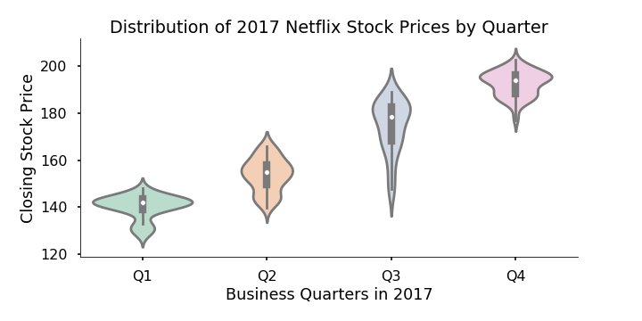
2017 Netflix stock prices per Quarter
This violin chart displays the distribution of Netflix stock price by quarter.
The white dot within each violin plot is the mean stock price of that quarter. We can see the mean price corresponds to the overall distribution of price fluctuations within the quarter, deemed by the widest point of each violin plot.
Quarter1 mean price: $140
Quarter 2 mean price: $153
Quarter 3 mean price: $178
Quarter 4 mean price: $197

Slide 4
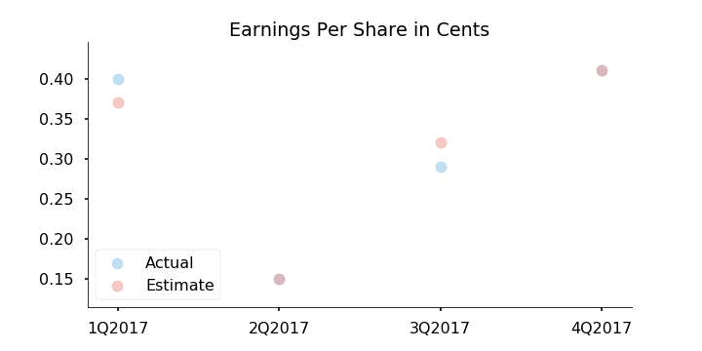
Estimated Vs. Actual Earnings Per Share
This scatter plot measures the Yahoo Finance projection of estimated EPS versus the actual EPS for Netflix, by quarter.
While the actual EPS was higher than the estimate in Q1, it was lower than the estimated EPS in Q3.
In Q2 and Q4, the estimated EPS and actual EPS were the same, thus overlapping on the scatter graph.
Q2 was an outlier at 15 cents EPS versus an average of 37 cents EPS in the other three quarters.

Slide 5
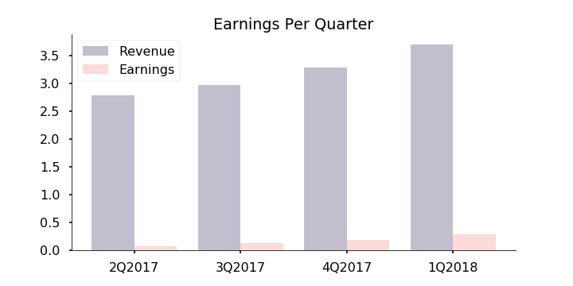
Netflix: Earnings Per Quarter
Both revenue and earnings gradually increased with each passing quarter.
Earnings maintains a very low percentage of revenue, however this percentage has increased.
In Q2 of 2017, earnings were roughly 0.4% of revenue.
In Q1 of 2018, earnings are roughly 1.08% of revenue.

Slide 6
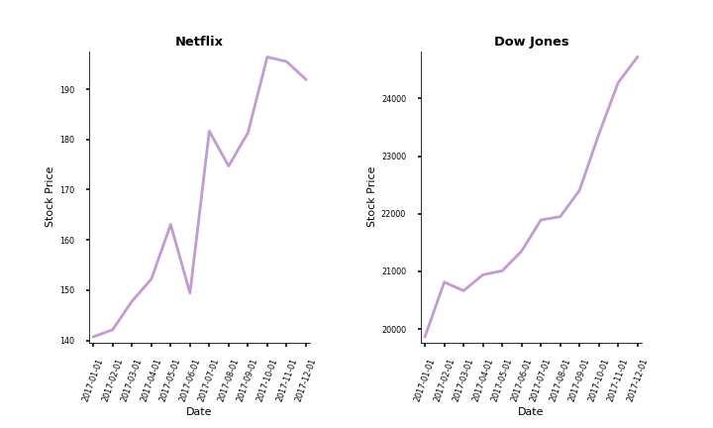
How Netflix Stock Price Compared to the Dow Jones Average over 2017:
Ultimately, both Netflix and the Dow Jones had positive stock price performance overall throughout 2017.
The growth of the Netflix stock price was much more volatile with severe drops in May and July.
The Netflix overall stock price started at around $140 and peaked around $200, however currently standing around $190.
The Dow Jones stock price started at $20,000 and peaked at $25,000 at the end of 2017.
Hello

